Slide 1


DADM Final Project
Data Source
From the Kaggle Data Repository
https://www.kaggle.com/pavansubhasht/ibm-hr-analytics-attrition-dataset
Acknowledgements:
Pavan Subhash
Team Members:
Mallika Srivastava, Mihika Gupta, Kavisha Jain, Ashani Shah

Slide 2
Uncover the factors that lead to employee attrition
Explore important relationships between variables and their relevance
breakdown of distance from home by job role and attrition
compare average monthly income by education and attrition
Predict Cross-Dependency of various data attributes contributing to attrition
Apply Data Analysis Techniques to find insights into the data and predict future occurrence of attrition based on these factors
Problem Statement

Slide 3
Fictional
Created by IBM data scientists
Total data: 1470 records
Shuffled to produce our results during analysis
About our Dataset
Variables
Independent
Dependent
All other variables excluding attrition
(see the following slide).
Attrition (voluntarily quitting workplace):
Binary class as:
Attrition : Yes == 1
Attrition : No == 0

Slide 4
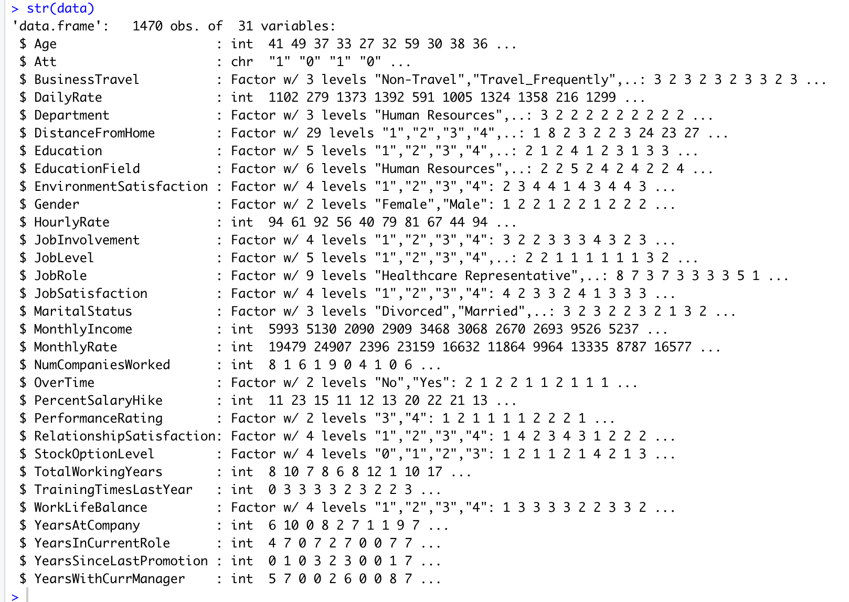
Variables:
Broad Factors:
Duration : Years at company, in current role, since last promotion and with current manager.
Personal: Age, Gender, marital status, education, relationship satisfaction.
Job: Job level, satisfaction, role, overtime
Monetary: Income, Salary Hike etc.

Slide 5
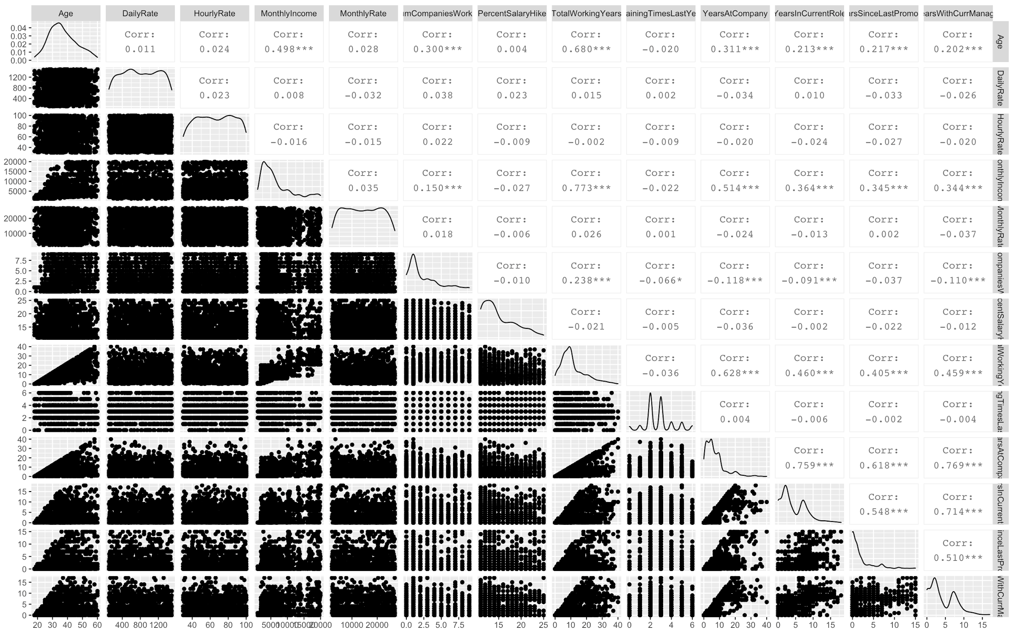
EXPLORATORY DATA ANALYSIS
Some variables were found to be highly correlated, and some were not.
Multicollinearity and heteroskedasticity was found and appropriate methods were used to tackle them.
High correlations were found for some variables like:
YearsAtCompany~YearsWithCurrManager 0.769
YearsAtCompany~YearsSinceLastPromotion 0.618
YearsAtCompany~YeasinCurrentRole
0.759
YearsinCurrentRole~YearsWithCurrManager 0.714
Box plots were used to find presence of outliers.
Anova Tests were performed to see what attributes, whether individually or collectively effect the attrition rate.
Logistic Regression was the major model that was used for our prediction, since our dependent variable was a binary category of 0 and 1 , While independent variables were a mixture of metric and factor variables.

Slide 6
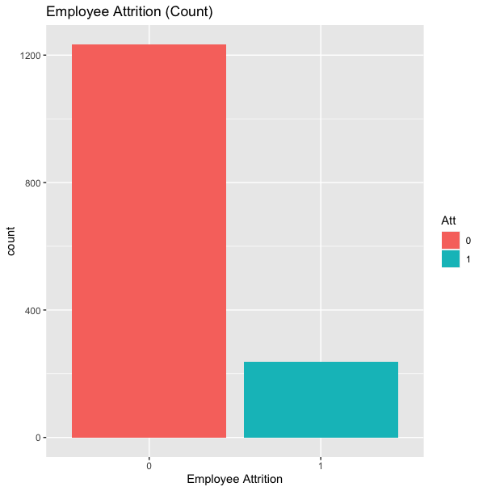
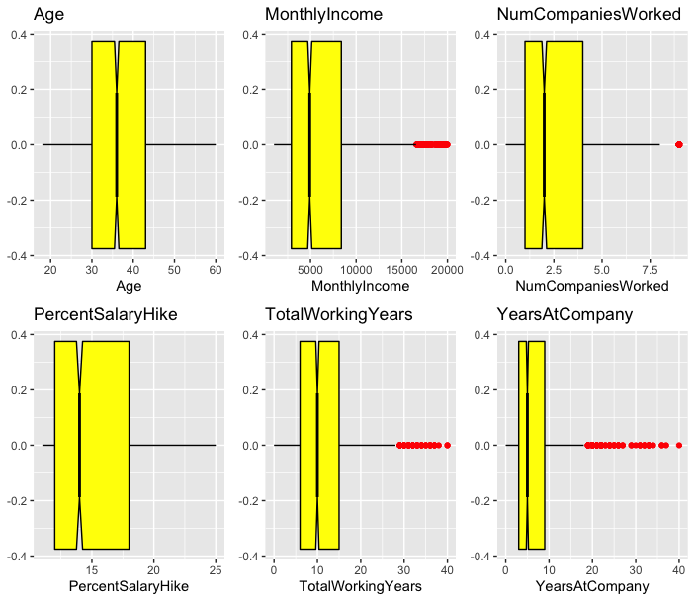
DATA DISTRIBUTION AND OUTLIER DETECTION
Checking for Outliers
Histogram of dependent variable distribution
The data was found to be imbalanced, most of the instances in the dataset belong to category 0(No Attrition), therefore the data was shuffled before use.
Therefore, after applying our models, k-Fold cross validation was done to get accurate classifications.
some outliers were detected through the boxplots which were explored further in the models.
slight skewness was observed in the variable distributions.

Slide 7
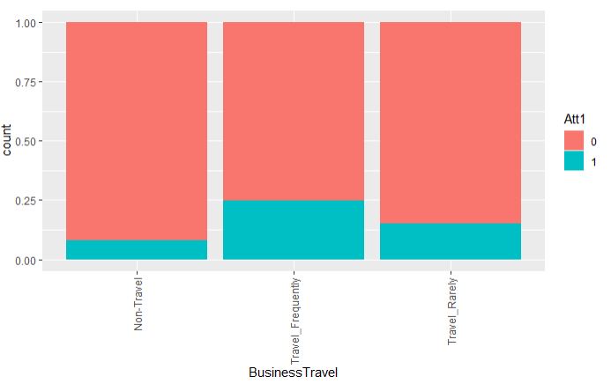
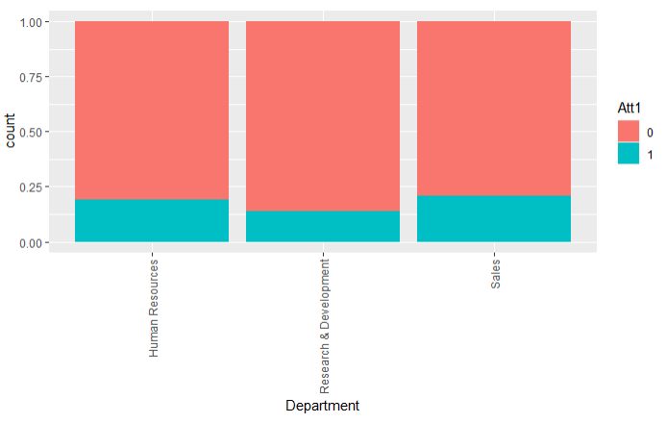
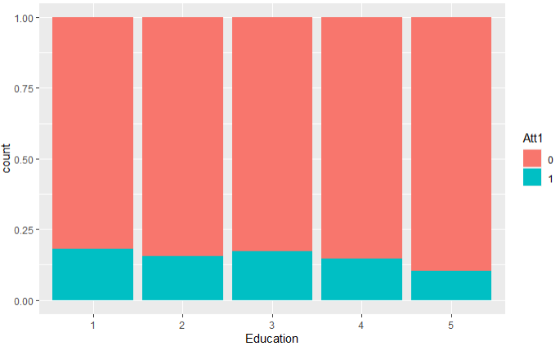
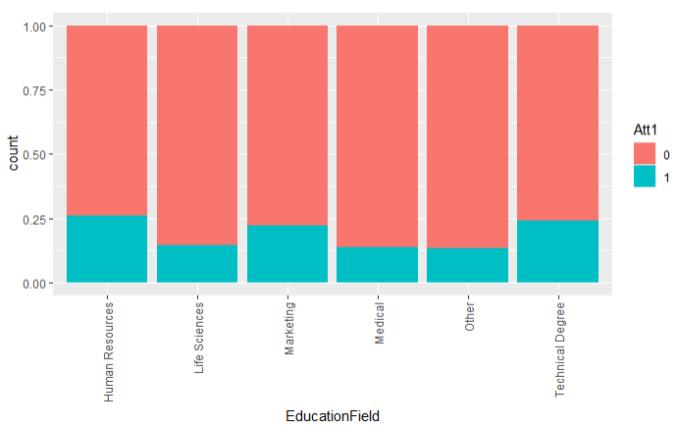
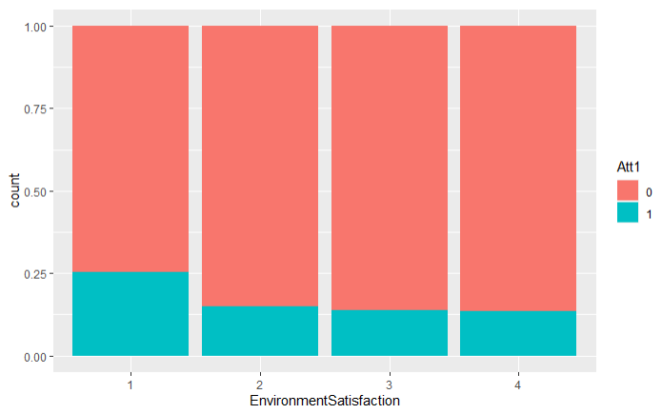
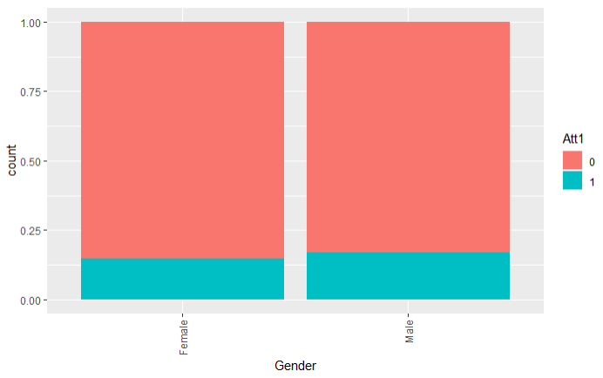
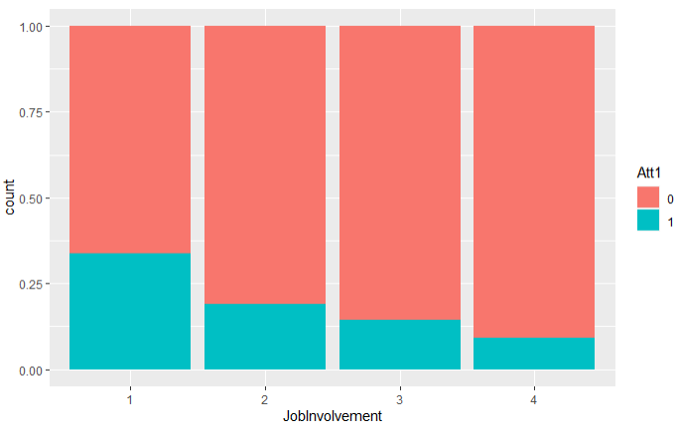
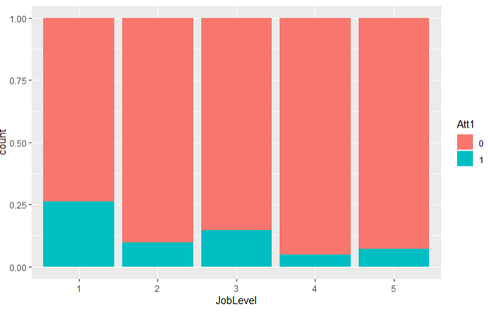
About our Categorical Variables
Notes:
In these plots, we can see certain variables which are likely to contribute more to potential models. We have percentages on the y axis, and different levels of factor variables on the x-axis.
To point out a few, lets look at business travel and environment satisfaction. We see that more frequent travel and lower levels of environment satisfaction are correlated with greater attrition, as in the bottom and top plots on the left. On the other hand, more job involvement has lower attrition.

Slide 8
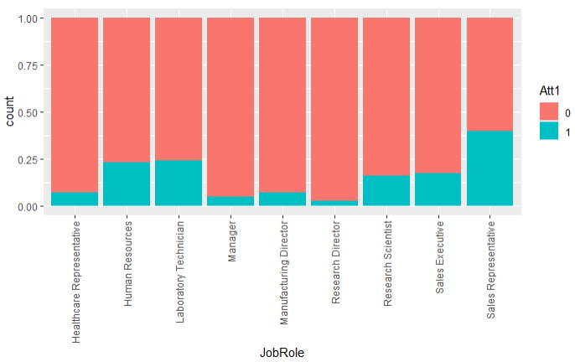
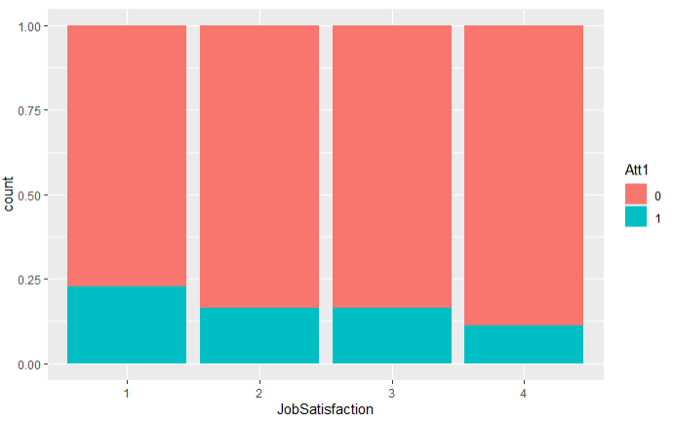
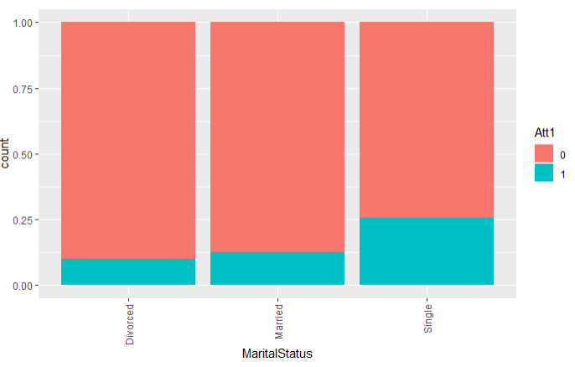
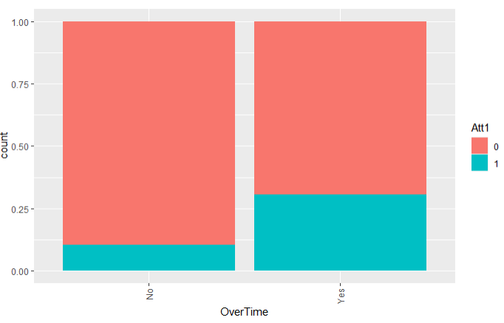
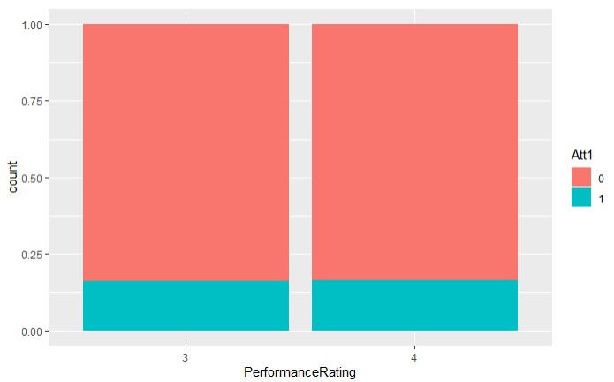
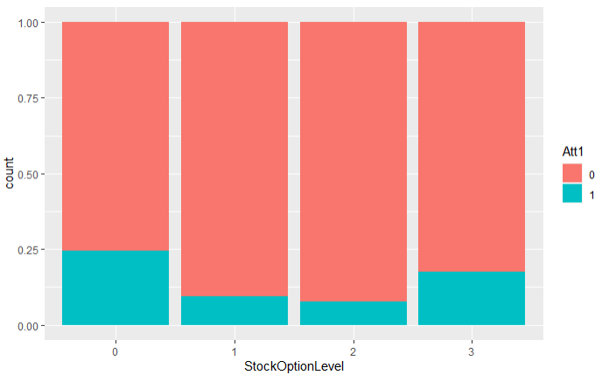
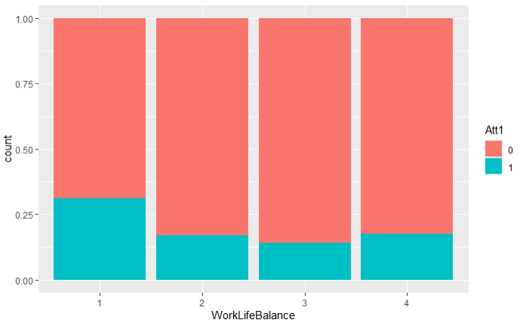
About our Categorical Variables
Notes:
In the top, left plots, we see that there seems to be greater attrition for married people than divorced people. We had expected to see more attrition among singles, which is also clear from this plot. Overtime is also correlated with a higher attrition level at 30 versus 10%.

Slide 9
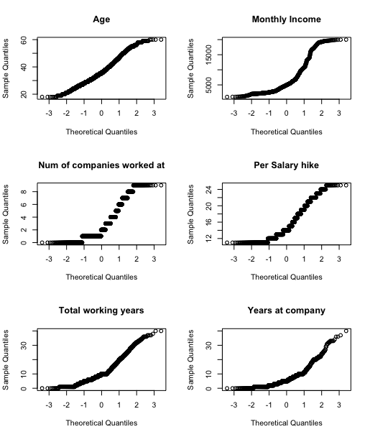
Checking Data Normality
Most of the data attributes seem almost normal
There is slight variations, but nothing major that we should be concerned about.
Notes:
To see if the variables were normally distributed, we performed a quick check of normality. A glance through the output, as seen on the right, reveals that most variables look normal with relatively straight lines, and we shouldn’t see any unevenness when generating our model, which will initially include all the variables, both factor and numerical. Due to slight variations in some variables, we also scaled our data for better accuracy.

Slide 10
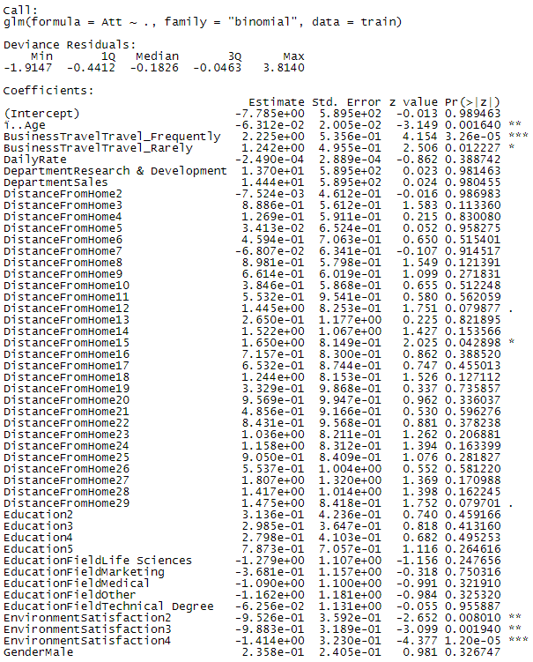
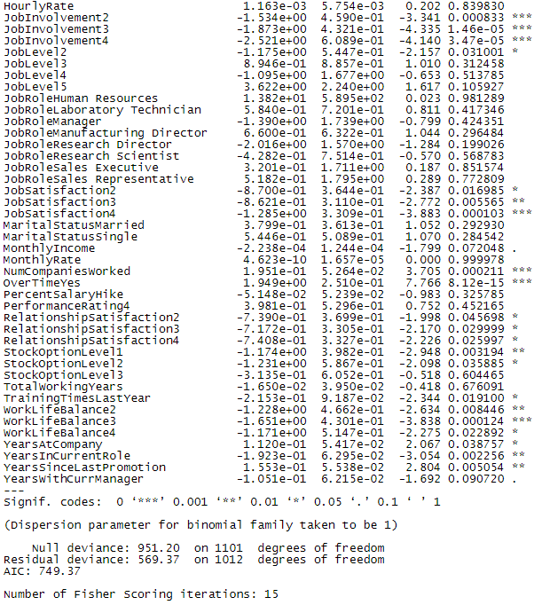
g1 model
Notes:
We have binomial data, so we couldn’t use a linear model. Instead, we used a generalized linear model function to predict attrition. In this logistic regression, we included all the variables and then will later remove what is irrelevant using the step function and continue refining the model. The summary output shows the coefficients and p-values for these variables.

Slide 11
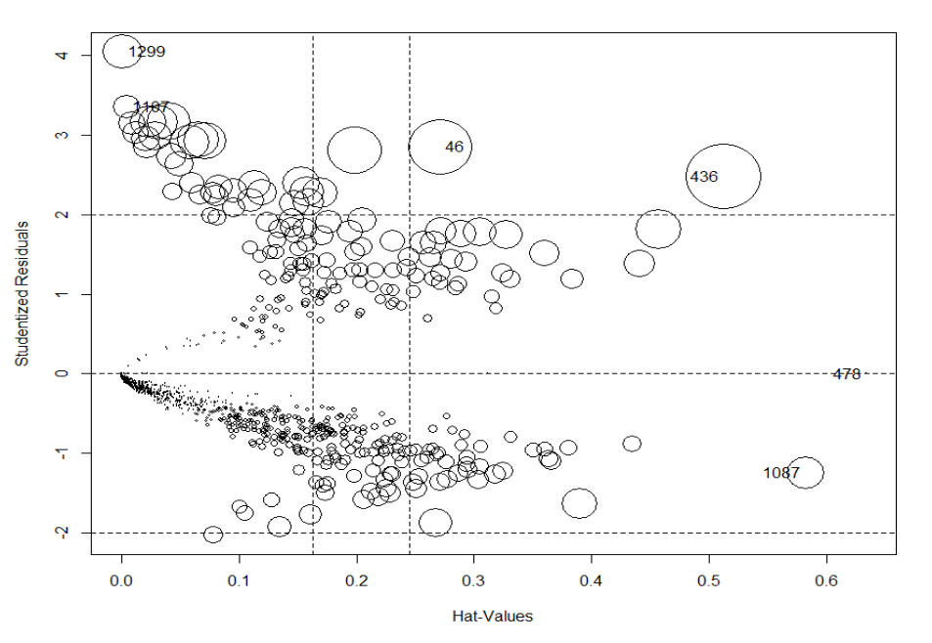
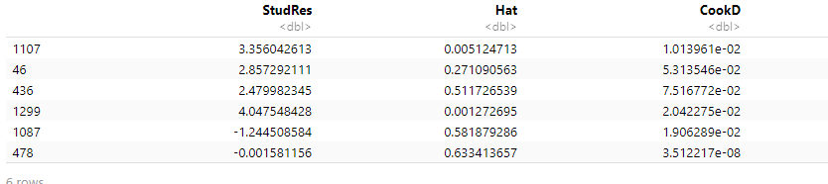
Cook’s Distance
# Influence plots
influencePlot(g1)
No influential outliers among data, as Cook’s Distance values are small, less than 0.1
Notes:
So we’ve explained what variables we’re going to use for generating our model. To perform a check for outliers and particularly influential data points, we calculated Cook’s distance using the influence plot function. As we can see from the cook’s d values in the table at the bottom, there are no influential outliers, and leverage is not an issue. To the right, we have our "bubble" plot of studentized residuals by hat values, with the areas of the circles representing the observations proportional to Cook's distances. Now, Kavisha will go into depth about continuing the model building and selection steps.

Slide 12
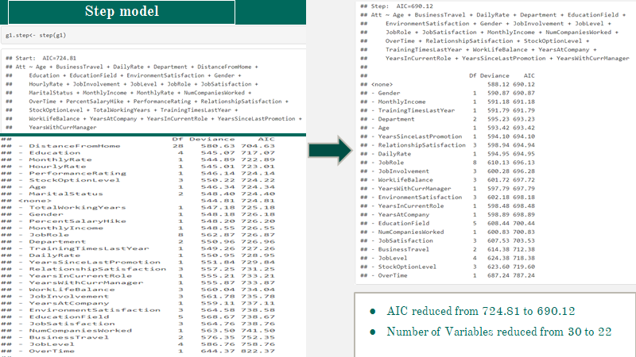

Slide 13
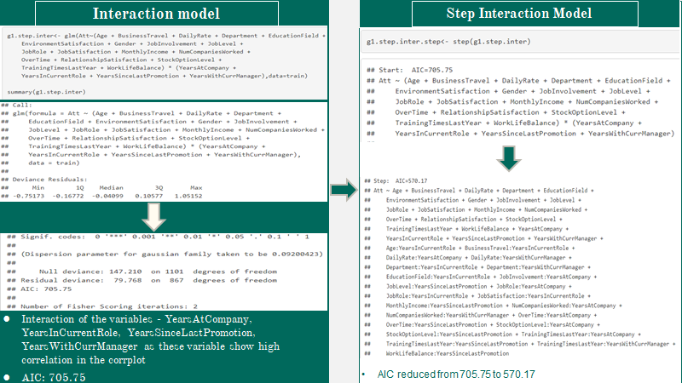

Slide 14
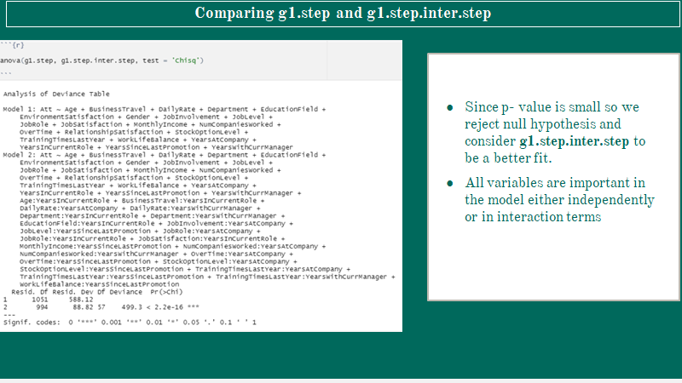

Slide 15
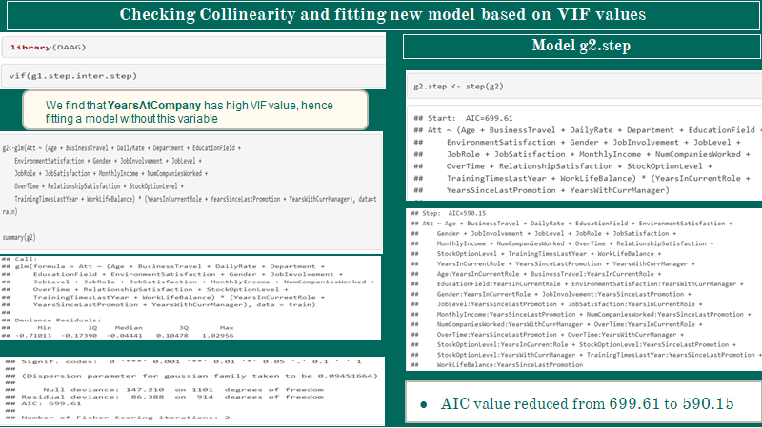

Slide 16
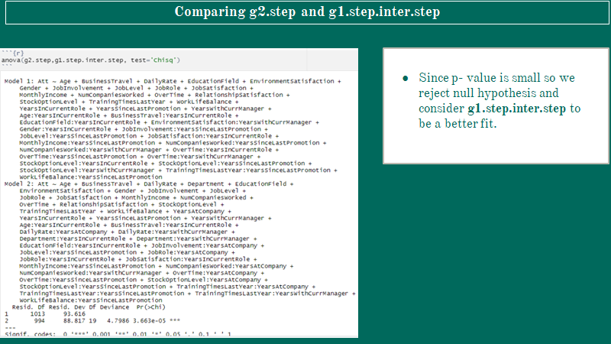

Slide 17
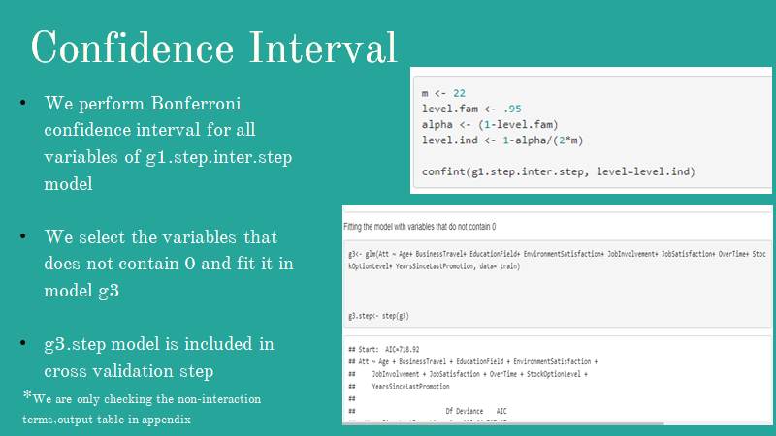

Slide 18
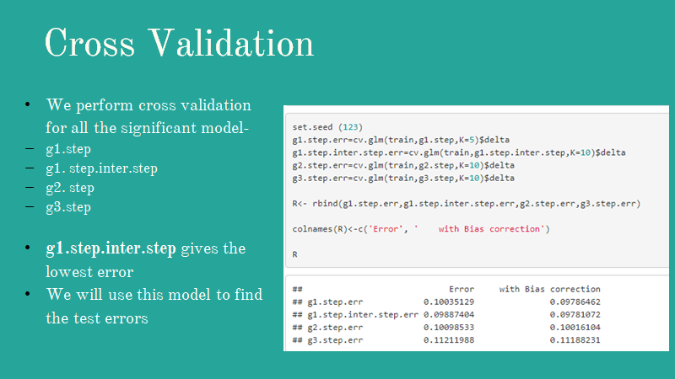

Slide 19
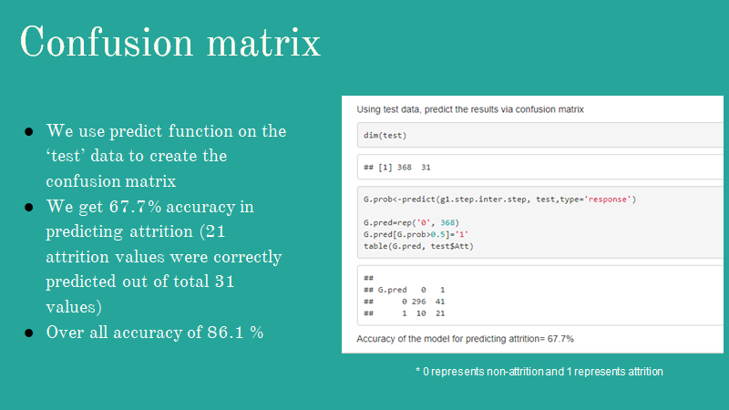

Slide 20
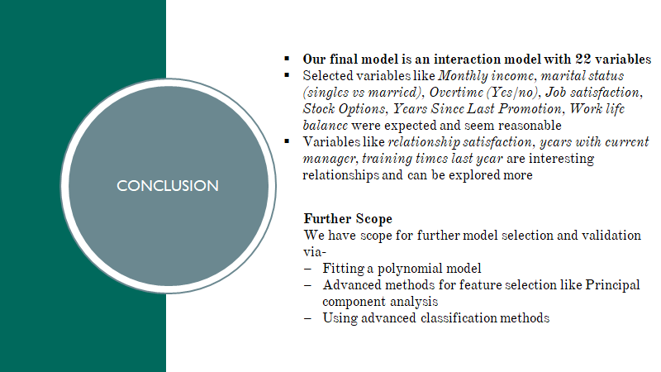

Slide 21
THANK YOU!

Slide 22
